Slide 1
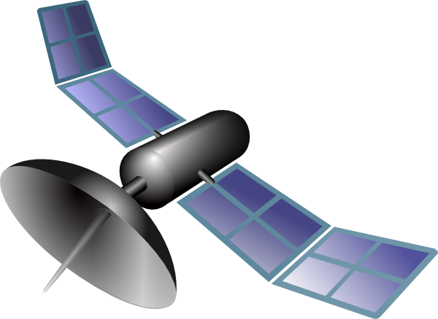
RPI Weather Station
Zuhair Khan

Slide 2
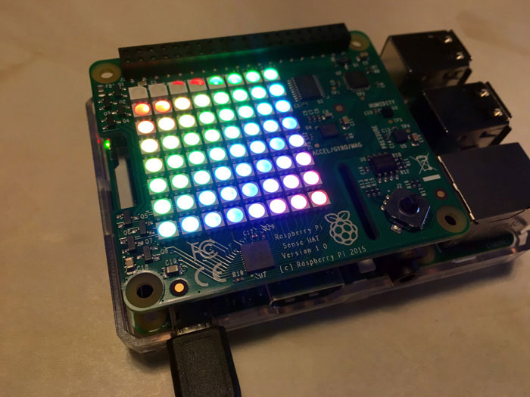
BACKGROUND
This initiative utilizes a Raspberry Pi 4 computer, programmed with a concise script, enabling it to collect and exhibit weather data from nearby regions. It also facilitates the sharing of this data on a weather station website. Considering the limitations of the computer and its hardware, absolute accuracy in the data cannot be guaranteed, yet the system consistently provides readings that are close to accurate.

Slide 3




ABOUT THE PROJECT
The objective of this project is to collect weather information from surrounding areas within a one mile radius.
The system employs a basic set of hardware components that are versatile enough to be mounted on any type of ground, be it soil, pavement, or concrete, in various environments.
Live weather updates are provided to a personal weather station network, which has been deactivated for the duration of this project to avoid incurring charges associated with this functionality.
This project is on GitHub, but for this project we customized it and made our own changes to the source code.

Slide 4
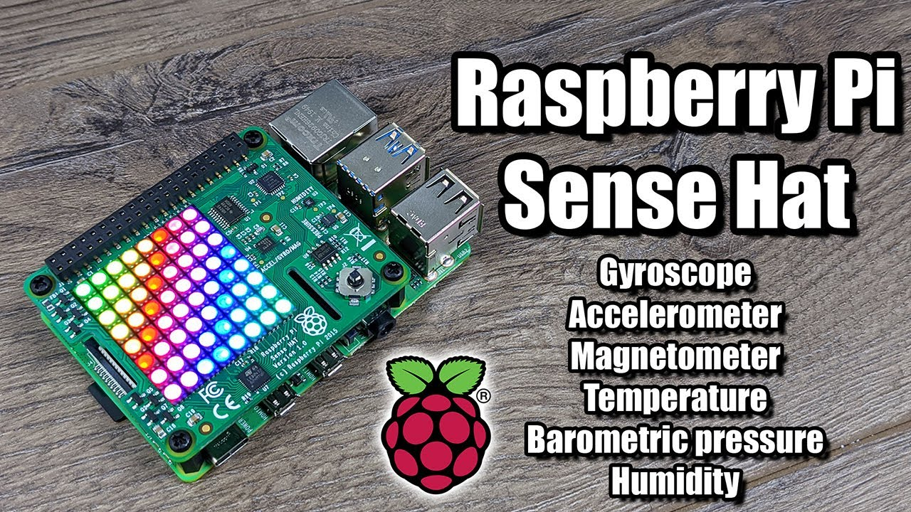
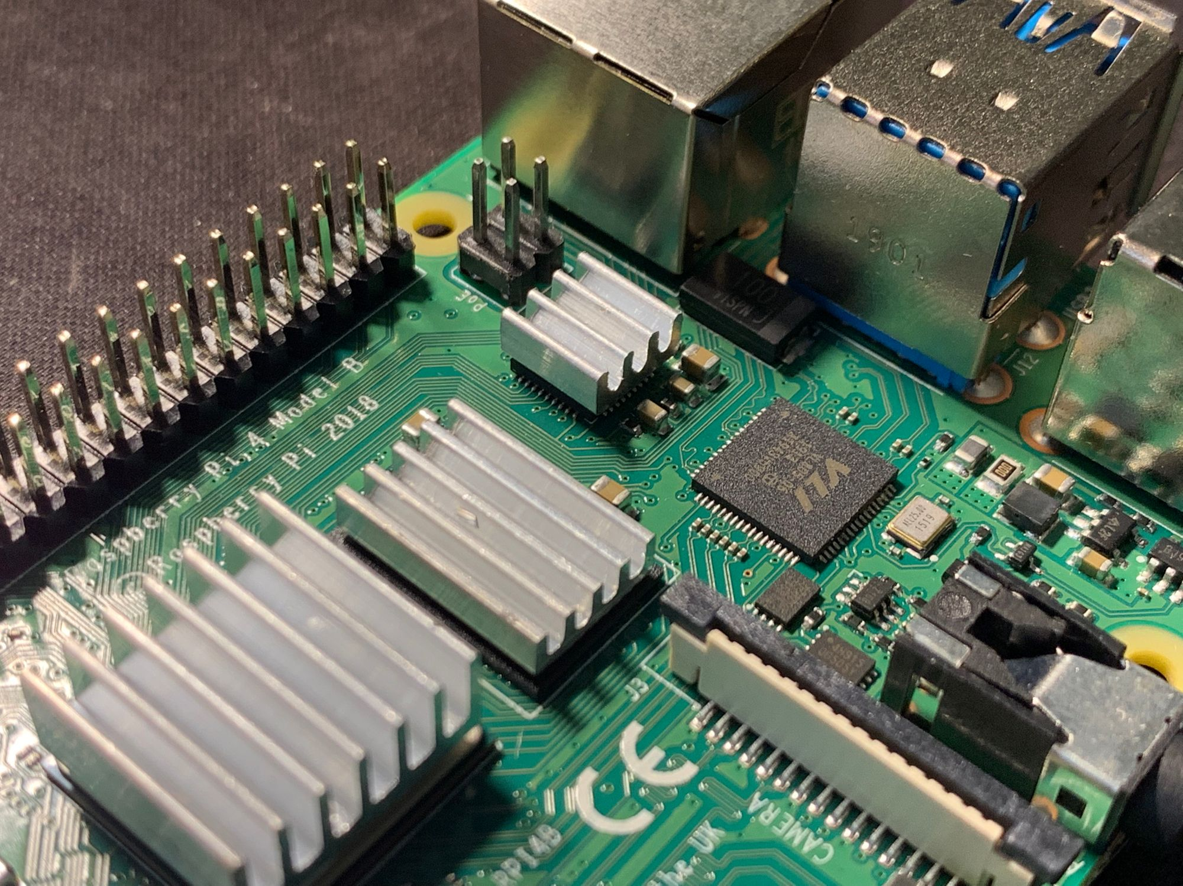
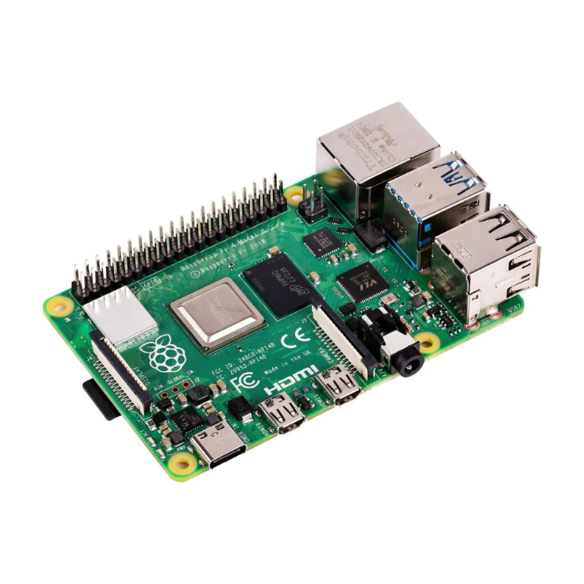
HARDWARE USED
1
2
3
Raspberry Pi 4
Sense Hat Sensor
Heat Sinks
The heat sinks keep the RPI temperature cool
The Sense Hat Sensor sits right on top of the Raspberry Pi board and has the following capabilities:
Temperature, humidity, and pressure sensors
5-button joystick
8 x 8 full-color RGB LED Display, (arrows point in up direction when temp increase detected, blue when temp decrease detected point down)
Accelerator

Slide 5

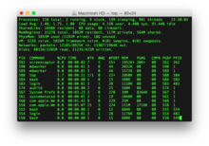
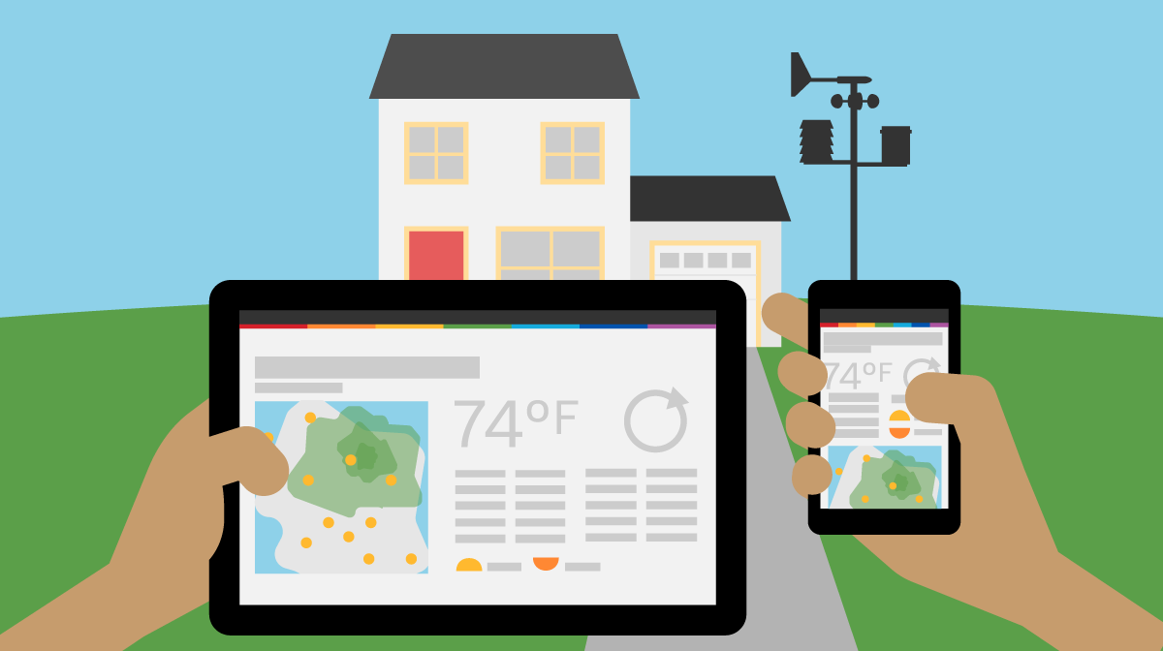
SOFTWARE
Python 3
Weather underground personal weather station network (Public weather service that lets you upload weather data into the WU database for public use)
Terminal

Slide 6
PROJECT APPROACH
The process to set up this project was straightforward. We started by affixing heat sinks to the CPU and RAM of the Raspberry Pi to stave off overheating. We then mounted the RPI Sense Hat onto the GPIO pins, a versatile device that brings together environmental sensing for temperature, humidity, and pressure, as well as orientation and sound detection. Subsequently, we registered for the Weather Underground Personal Station Network, obtaining a distinctive ID and API key. Next, we located the program's source code on GitHub, tailored it to suit our requirements, and integrated the API key and ID. Upon executing the program, we successfully received real-time data, including humidity and temperature readings.

Slide 7

CONCLUSION
This wasn’t a very complicated project, but simply required some programming and thinking. We can see this project is used in many places if used properly. One very important thing that we learned after completing this project are capabilities of the Sense Hat. It can enable Raspberry Pi to complete a large variety of tasks that it could not have done on its own.

Slide 8
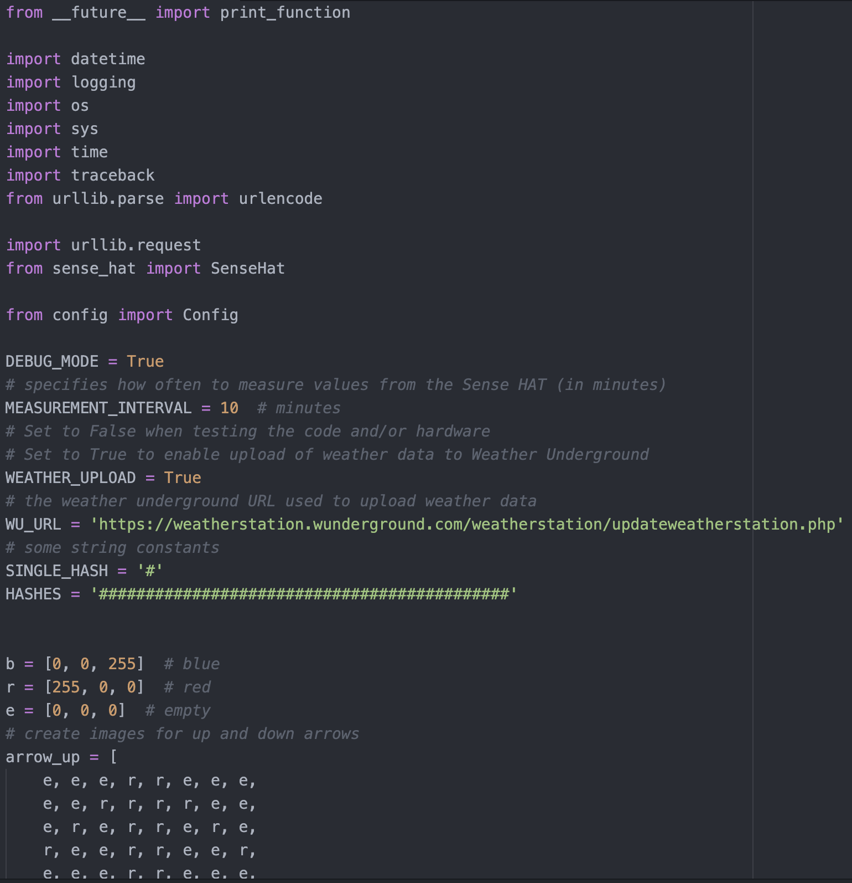
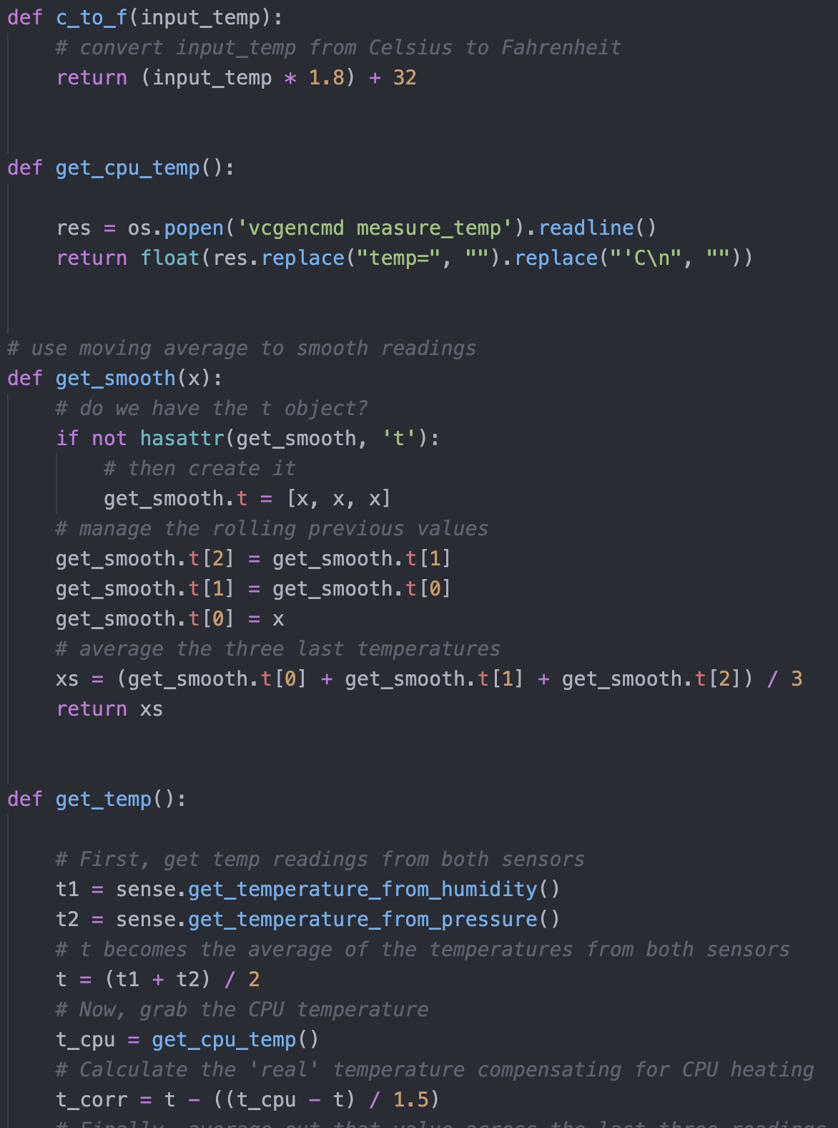
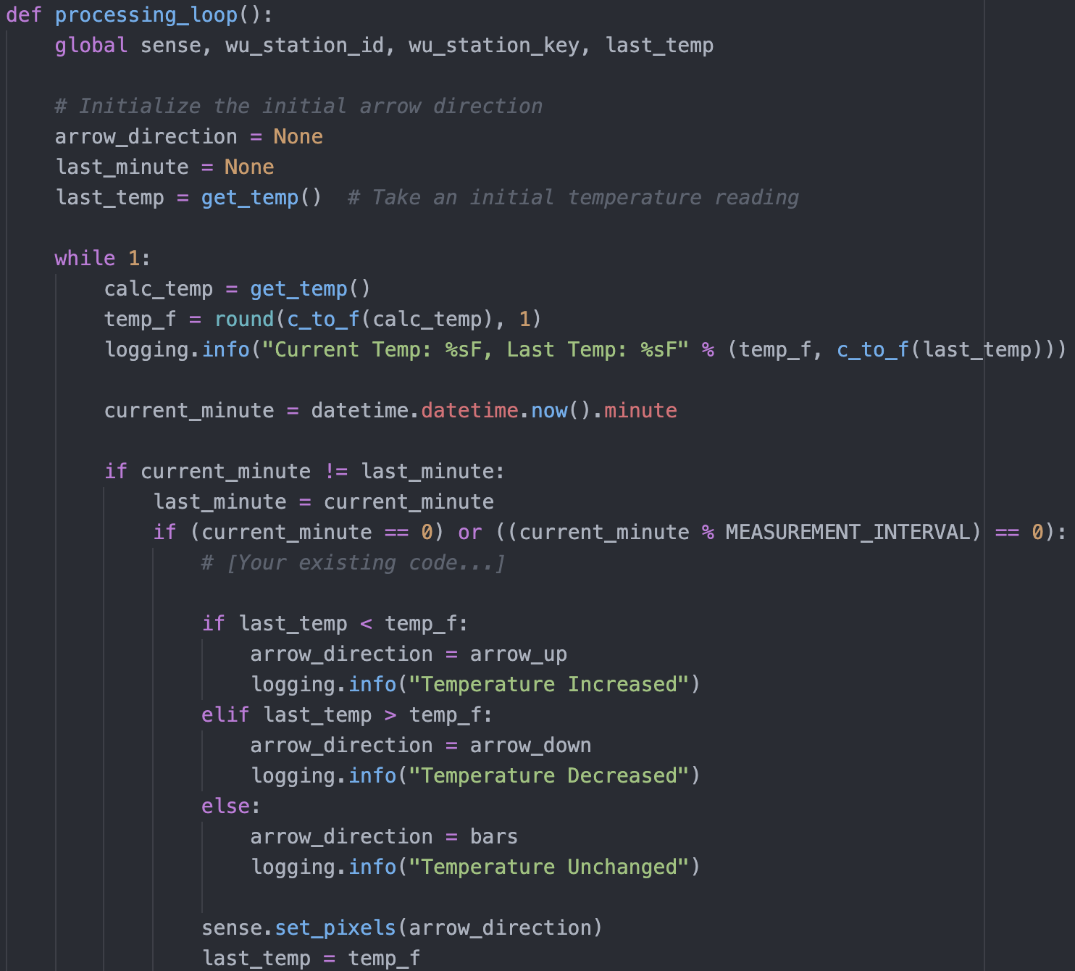
SOURCE CODE

Slide 9

THANK YOU!
Feel free to ask if you have any questions!

